Slide 2
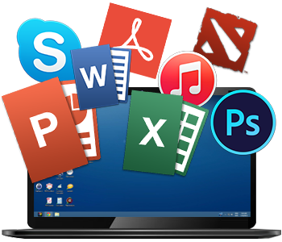
TYPES OF
APPLICATION

Slide 3
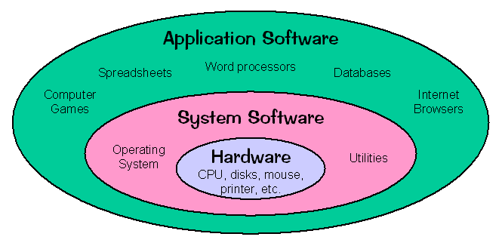
Software Classification
SYSTEM
SOFTWARE
APPLICATION
SOFTWARE

Slide 4
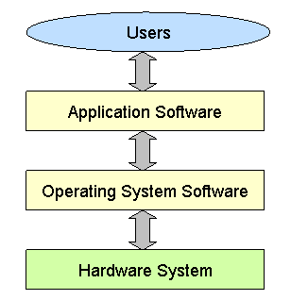
Software Hierarchy

Slide 5
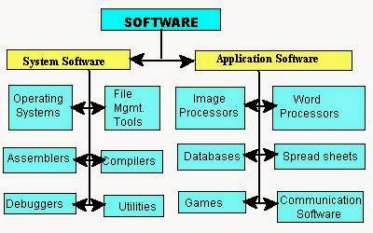
System and Application Software

Slide 6
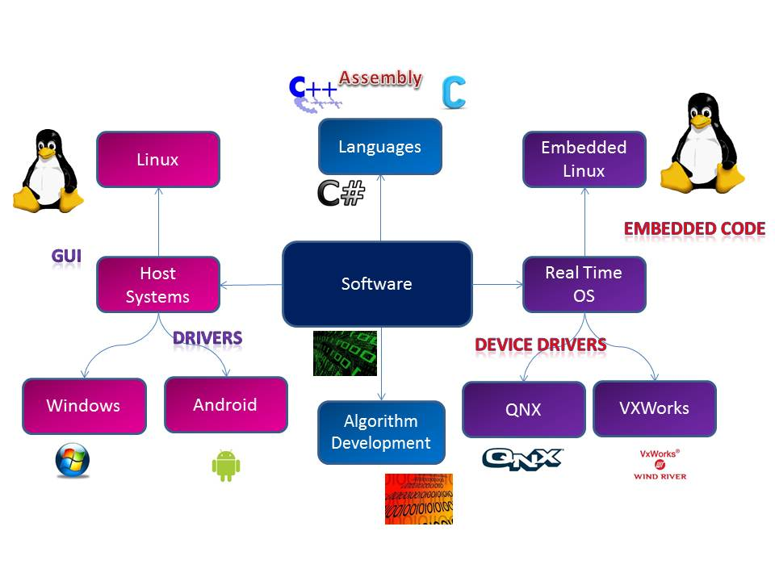
System Software Types

Slide 7
Application Software Types
Word Processing Software
Database Software
Spreadsheet Software
Multimedia Software
Presentation Software
Enterprise Software
Information Worker Software
Educational Software
Simulation Software
Content Access Software
Application Suites
Engineering & Product Development

Slide 8
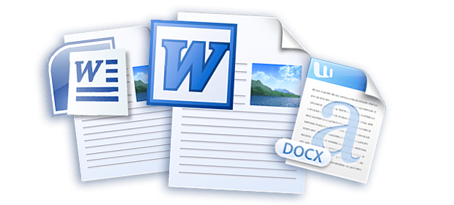
Word Processing Software
EXAMPLES :
MS Word
Wordpad
Notepad

Slide 9
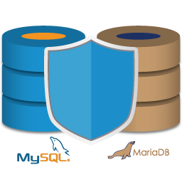
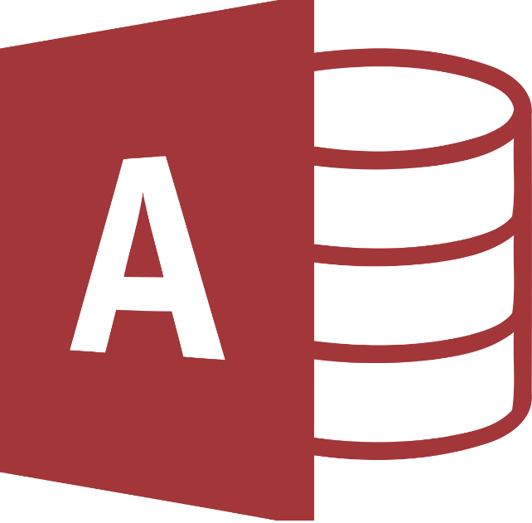

Database Software
EXAMPLES :
Oracle
MySQL
MS Access

Slide 10

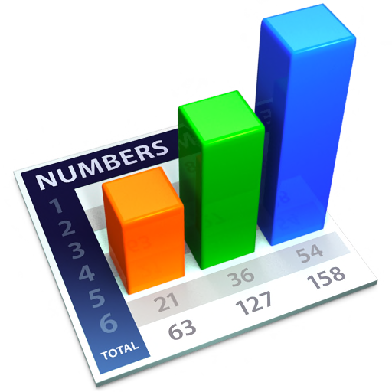
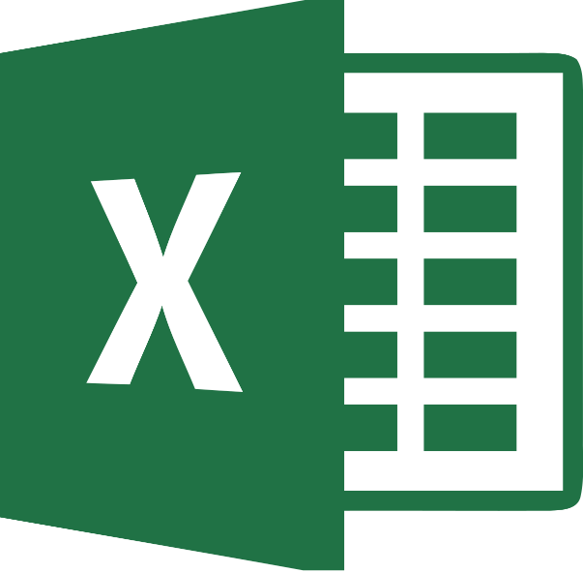
Spreadsheet Software
EXAMPLES :
Apple Numbers
Microsoft Excel

Slide 11



Multimedia Software
EXAMPLES :
iTunes
Media Player

Slide 12

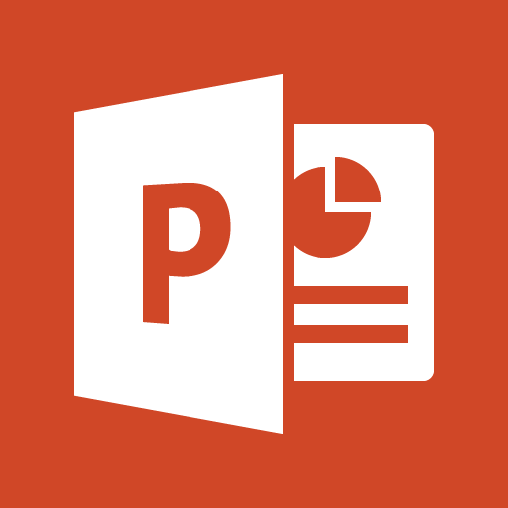
Presentation Software
EXAMPLES :
Microsoft Power Point
Keynotes

Slide 13
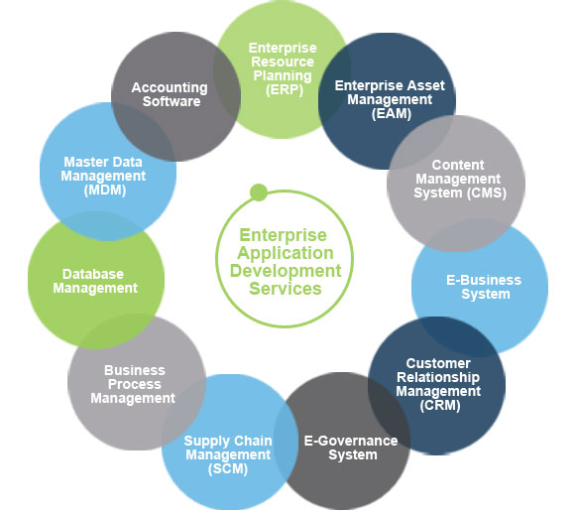
Enterprise Software
EXAMPLES :
Customer relationship
management system

Slide 14
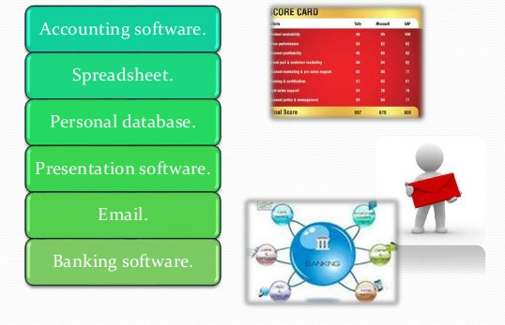
Information Worker Software
EXAMPLES :
Documentation tools
Resource management tools

Slide 15




Educational Software
EXAMPLES :
Dictionaries: Encarta, Britannica
Mathematical: MATLAB
Others: Google Earth, NASA World Wind

Slide 16
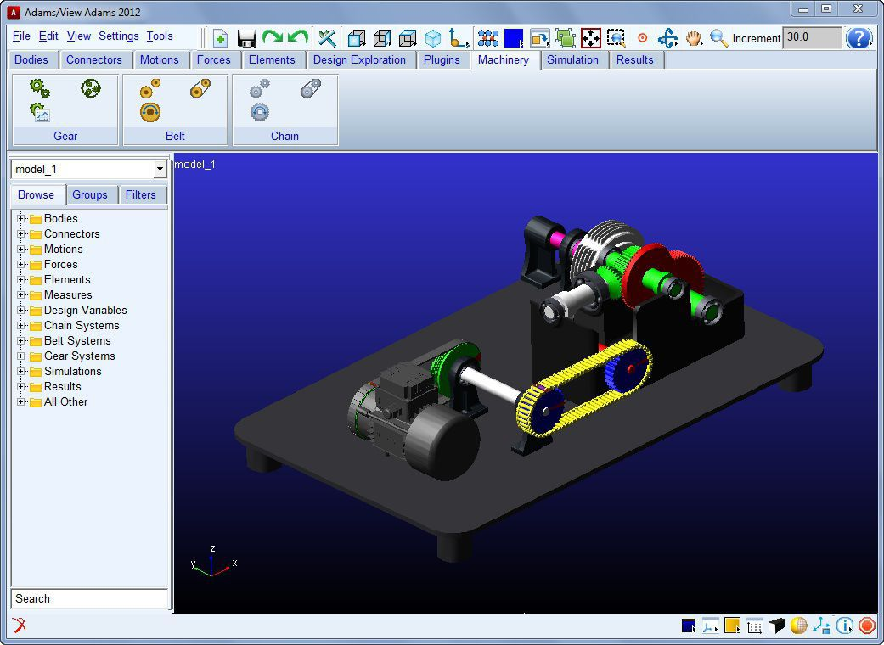
Simulation Software
EXAMPLES :
Flight and scientific simulators

Slide 17
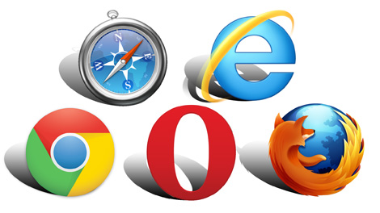
Content Access Software
EXAMPLES :
Accessing content through media players, web browsers

Slide 18
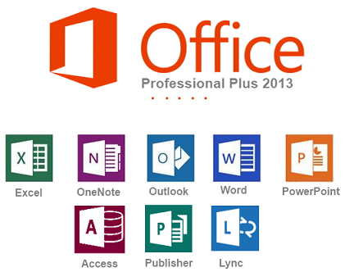
Application Suites
EXAMPLES :
OpenOffice
Microsoft Office

Slide 19

Software for Engineering and Product Development
EXAMPLES :
IDEs

Slide 20
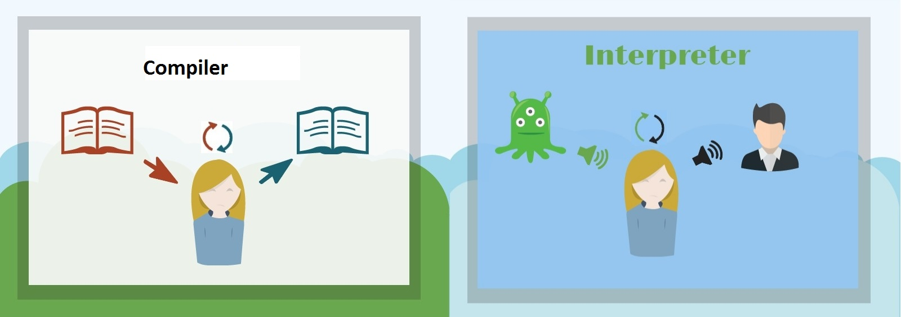
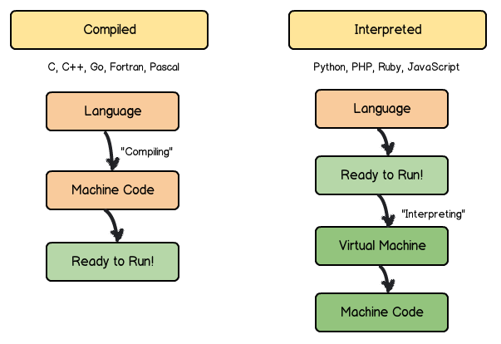
Compiler vs. Interpreter
The Compiler translates the entire program before it is run.
The Interpreters translates one statement into machine language, executes it, and proceeds to next statement.

Slide 21
API

Slide 22
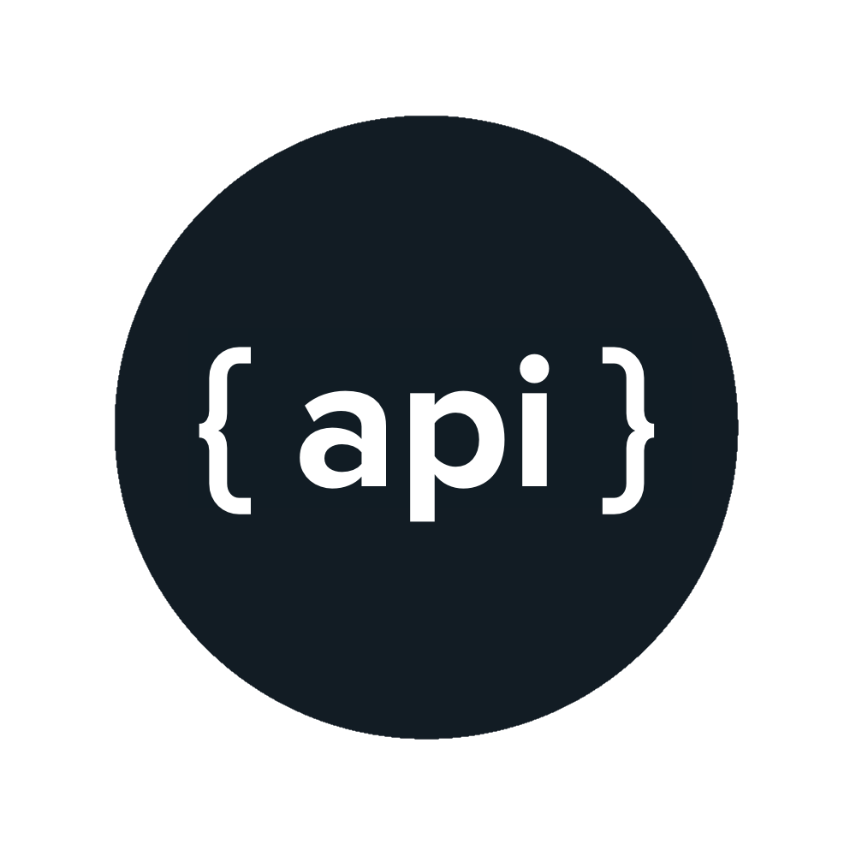
Application Programming Interface
An API is a software intermediary that allows two applications to talk to each other. In other words, an API is the messenger that delivers your request to the provider that you’re requesting it from and then delivers the response back to you.

Slide 23
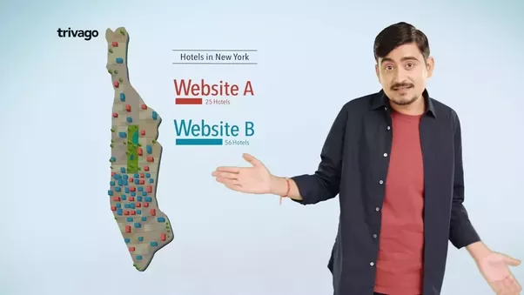
Real world Example : TRIVAGO

Slide 24
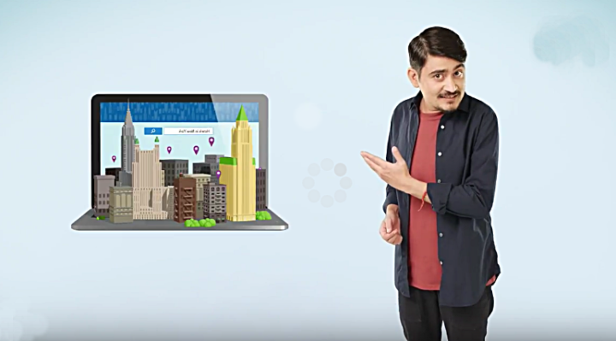
How it works ?
You’re searching for a hotel room from an online travel booking site. Using the site’s online form, you select the city you want to stay in, check-in and checkout dates, number of guests, and number of rooms. Then you click “search.”
As you may know, the travel site aggregates information from many different hotels. When you click “search,” the site then interacts with each hotel’s API, which delivers results for available rooms that meet your criteria. This can all happen within seconds because of an API, which acts like a messenger that runs back and forth between applications, databases, and devices.

Slide 25
Let’s see
https://www.trivago.in/

Slide 26
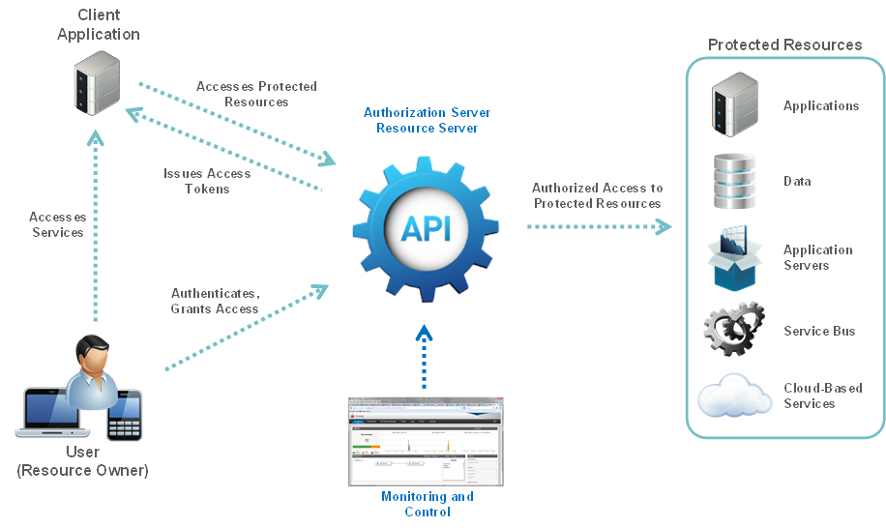
Working Summary

